Slide 1


DIYALA UNIVERSITY
COLLEGE OF ENGINEERING
DEPARTMENT OF COMMUNICATION ENGINEERING
Electronic Circuits II
Second Year_ Lecture 2
lecturer
Wisam Hayder
2021

Slide 2
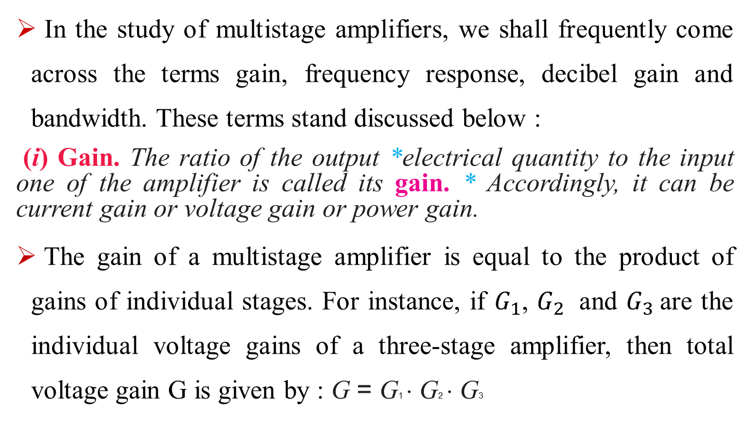
3. Important Terms
In the study of multistage amplifiers, we shall frequently come across the terms gain, frequency response, decibel gain and bandwidth. These terms stand discussed below :
(i) Gain. The ratio of the output *electrical quantity to the input one of the amplifier is called its gain. * Accordingly, it can be current gain or voltage gain or power gain.
The gain of a multistage amplifier is equal to the product of gains of individual stages. For instance, if $G_{1}$, $G_{2}$ and $G_{3}$are the individual voltage gains of a three-stage amplifier, then total voltage gain G is given by : G = G1 ⋅ G2 ⋅ G3
Notes:
aaa

Slide 3
3. Important Terms
(ii) Frequency response. The voltage gain of an amplifier varies with signal frequency.
It is because reactance of the capacitors in the circuit changes with signal frequency and hence affects the output voltage.
The curve between voltage gain and signal frequency of an amplifier is known as frequency response.
Notes:
aaa

Slide 4
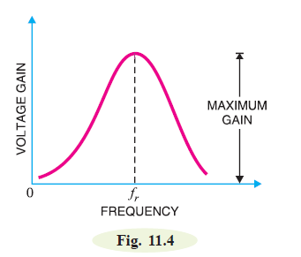
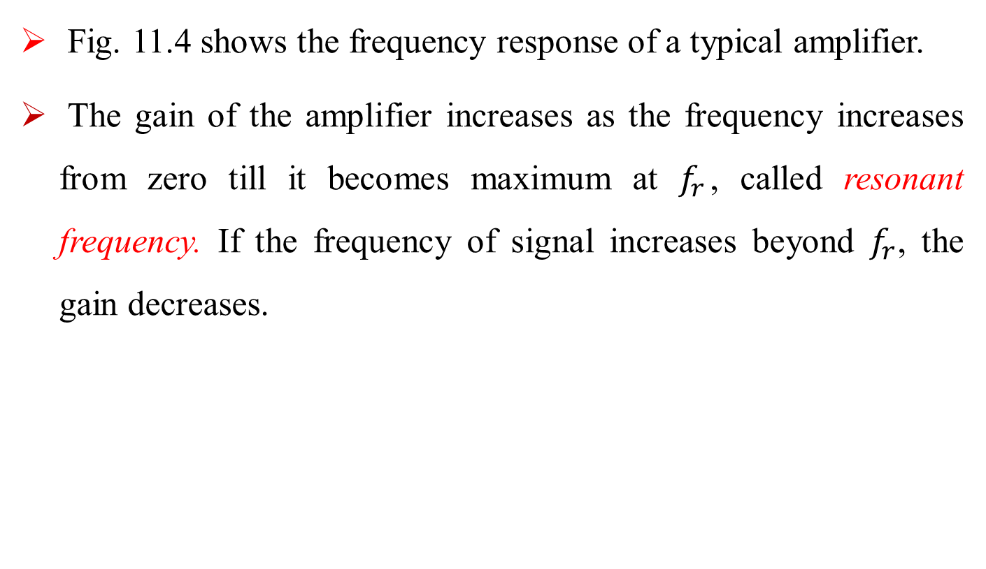
3. Important Terms
Fig. 11.4 shows the frequency response of a typical amplifier.
The gain of the amplifier increases as the frequency increases from zero till it becomes maximum at $f_{r}$, called resonant frequency. If the frequency of signal increases beyond $f_{r}$, the gain decreases.
Notes:
aaa

Slide 5
3. Important Terms
The performance of an amplifier depends to a considerable extent upon its frequency response.
While designing an amplifier, appropriate steps must be taken to ensure that gain is essentially uniform over some specified frequency range.
For instance, in case of an audio amplifier, which is used to amplify speech or music, it is necessary that all the frequencies in the sound spectrum (i.e. 20 Hz to 20 kHz) should be uniformly amplified otherwise speaker will give a distorted sound output.
Notes:
aaa

Slide 6
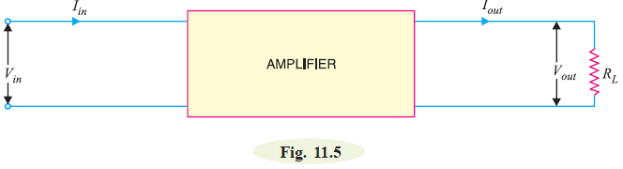
3. Important Terms
(iii) Decibel gain. Although the gain of an amplifier can be expressed as a number, yet it is of great practical importance to assign it a unit.
The unit assigned is bel or decibel (db).
The common logarithm (log to the base 10) of power gain is known as bel power gain i.e.
Notes:
aaa

Slide 7

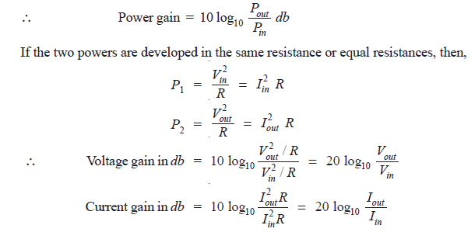
3. Important Terms
Notes:
aaa

Slide 8
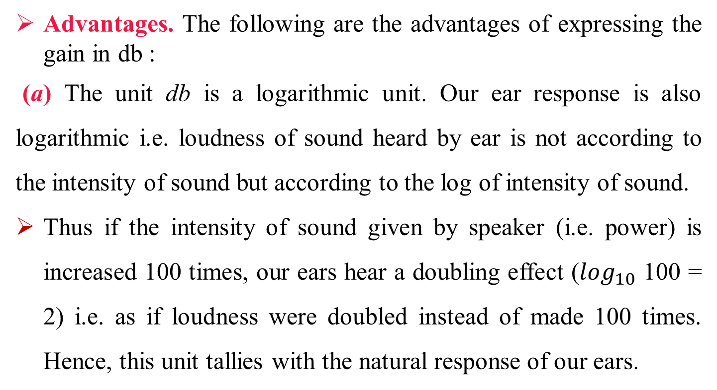
3. Important Terms
Advantages. The following are the advantages of expressing the gain in db :
(a) The unit db is a logarithmic unit. Our ear response is also logarithmic i.e. loudness of sound heard by ear is not according to the intensity of sound but according to the log of intensity of sound.
Thus if the intensity of sound given by speaker (i.e. power) is increased 100 times, our ears hear a doubling effect ($\log_{10}$ 100 = 2) i.e. as if loudness were doubled instead of made 100 times. Hence, this unit tallies with the natural response of our ears.
Notes:
aaa

Slide 9
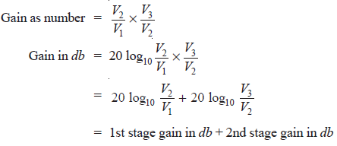
3. Important Terms
(b) When the gains are expressed in db, the overall gain of a multistage amplifier is the sum of gains of individual stages in db.
Thus referring to Fig. 11.6,
Notes:
aaa

Slide 10
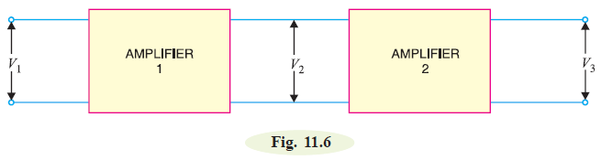
3. Important Terms
However, absolute gain is obtained by multiplying the gains of individual stages.
Obviously, it is easier to add than to multiply.
Notes:
aaa

Slide 11
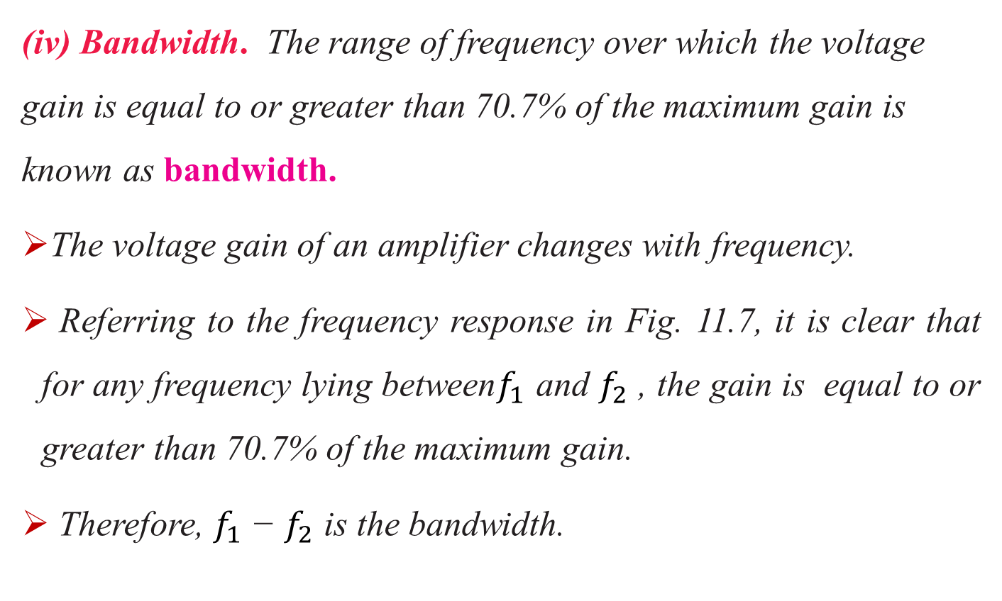
3.Important Terms
(iv) Bandwidth. The range of frequency over which the voltage gain is equal to or greater than 70.7% of the maximum gain is known as bandwidth.
The voltage gain of an amplifier changes with frequency.
Referring to the frequency response in Fig. 11.7, it is clear that for any frequency lying between$f_{1}$ and $f_{2}$ , the gain is equal to or greater than 70.7% of the maximum gain.
Therefore, $f_{1}$ − $f_{2}$ is the bandwidth.
Notes:
aaa

Slide 12
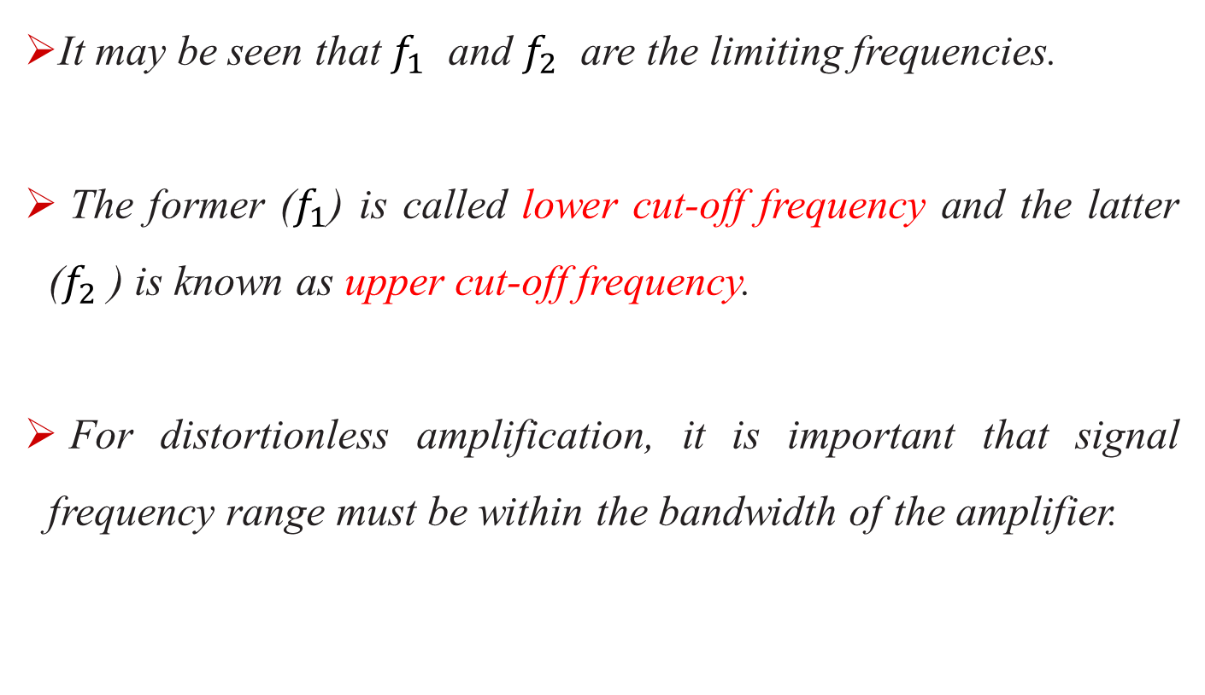
3. Important Terms
It may be seen that${ f}_{1}$ and $f_{2}$ are the limiting frequencies.
The former ($f_{1}$) is called lower cut-off frequency and the latter ($f_{2}$ ) is known as upper cut-off frequency.
For distortionless amplification, it is important that signal frequency range must be within the bandwidth of the amplifier.
Notes:
aaa

Slide 13
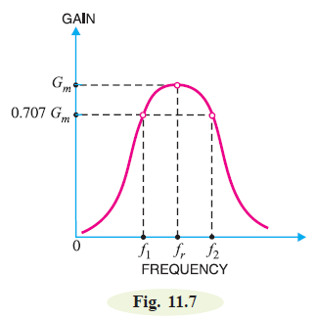

3. Important Terms
The bandwidth of an amplifier can
also be defined in terms of db.
Suppose the maximum voltage
gain of an amplifier is 100.
Then 70.7% of it is 70.7.
∴ Fall in voltage gain from maximum
gain.
Notes:
aaa

Slide 14
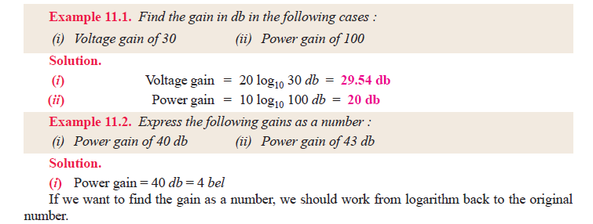
3. Important Terms
Hence bandwidth of an amplifier is the range of frequency at the limits of which its voltage gain falls by 3 db from the maximum gain.
The frequency f1 or f2 is also called 3-db frequency or half-power frequency.
Notes:
aaa

Slide 15
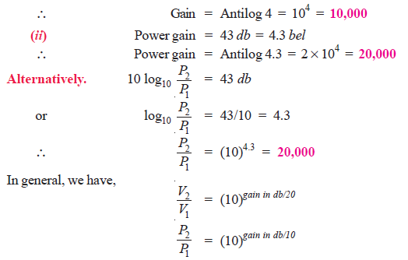
3. Important Terms
Notes:
aaa

Slide 16
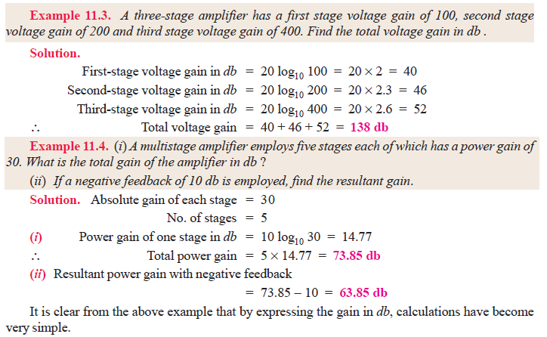
3. Important Terms
Notes:
aaa

Slide 17
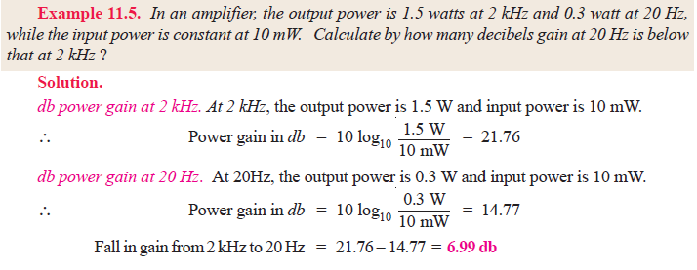
3. Important Terms
Notes:
aaa

Slide 18
3. Important Terms
Homework
1- A certain amplifier has voltage gain of 15 db. If the input signal voltage is 0.8V, what is the output voltage ?
2- An amplifier has an open-circuit voltage gain of 70 db and an output resistance of 1.5 k Ω
Determine the minimum value of load resistance so that voltage gain is not more than 67db.
3- An amplifier feeding a resistive load of 1k Ω has a voltage gain of 40 db. If the input signal is 10 mV, find (i) output voltage (ii) load power.
4- An amplifier rated at 40W output is connected to a 10 Ω speaker.
(i) Calculate the input power required for full power output if the power gain is 25 db.
(ii) Calculate the input voltage for rated output if the amplifier voltage gain is 40 db.

Slide 19
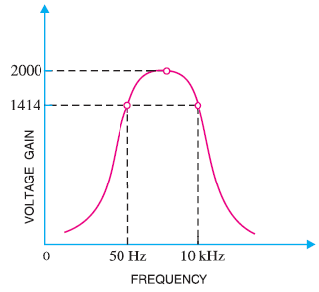
3. Important Terms
Question: In an amplifier, the maximum voltage gain is 2000 and occurs at 2 kHz. It falls to 1414 at 10 kHz and 50 Hz. Find :
(i) Bandwidth (ii) Lower cut-off frequency (iii) Upper cut-off frequency.
Solution.
(i) Referring to the frequency response in Fig.
the maximum gain is 2000. Then 70.7% of
this gain is 0.707 ⋅ 2000 = 1414. It is given
that gain is 1414 at 50 Hz and 10 kHz. As
bandwidth is the range of frequency over
which gain is equal or greater than 70.7%
of maximum gain, ∴ Bandwidth = 50 Hz to 10 kHz
(ii) The frequency (on lower side) at which the
voltage gain of the amplifier is exactly 70.7%
of the maximum gain is known as lower cut-off frequency.
Referring to Fig. 11.8, it is clear that :
Lower cut-off frequency = 50 Hz
(iii) The frequency (on the higher side) at which
the voltage gain of the amplifier is exactly 70.7% of the maximum gain is known as upper
cut-off frequency. Referring to Fig. 11.8, it is clear that: Upper cut-off frequency = 10 kHz

Slide 20
4. Properties of db Gain
The power gain expressed as a number is called ordinary power gain. Similarly, the voltage gain expressed as a number is called ordinary voltage gain.
1. Properties of db power gain. The following are the useful rules
for db power gain :
(i) Each time the ordinary power gain increases (decreases) by a
factor of 10, the db power gain increases (decreases) by 10 db.
For example, suppose the ordinary power gain increases from
100 to 1000 (i.e. by a factor of 10).
∴ Increase in db power gain = 10 log10 1000 – 10 log10 100
= 30 – 20 = 10 db
This property also applies for the decrease in power gain.

Slide 21
4. Properties of db Gain
(ii) Each time the ordinary power gain increases (decreases) by a
factor of 2, the db power gain increases (decreases) by 3 db.
For example, suppose the power gain increases from 100 to 200
(i.e. by a factor of 2).
∴ Increase in db power gain = 10 log10 200 – 10 log10 100
= 23– 20 = 3 db
2. Properties of db voltage gain. The following are the useful rules
for db voltage gain :
(i) Each time the ordinary voltage gain increases (decreases) by a
factor of 10, the db voltage gain increases (decreases) by 20 db.

Slide 22
4. Properties of db Gain
For example, suppose the voltage gain increases from 100 to 1000 (i.e. by a factor of 10).
∴ Increase in db voltage gain = 20 log10 1000 – 20 log10 100
= 60 – 40 = 20 db
(ii) Each time the ordinary voltage gain increases (decreases) by a
factor of 2, the db voltage gain increases (decreases) by 6 db.
For example, suppose the voltage gain increases from 100 to 200
(i.e. by a factor of 2).
∴ Increase in db voltage gain = 20 log10 200 – 20 log10 100
= 46 – 40 = 6 db

